Slide 1
Heap & Heapsort
3rd Grade
College of Computer Science and Information Technology
Department of Computer Science
Data Structures
Lecture 10
Instructor: Ghazwan Abdulnabi Al-Ali
University of Basrah, Iraq

Slide 2
Heaps
The (Binary) heap data structure is an array object that can be viewed as a nearly complete binary tree.
A binary tree with n nodes and depth k is complete iff its nodes correspond to the nodes numbered from 1 to n in the full binary tree of depth k.

Slide 4
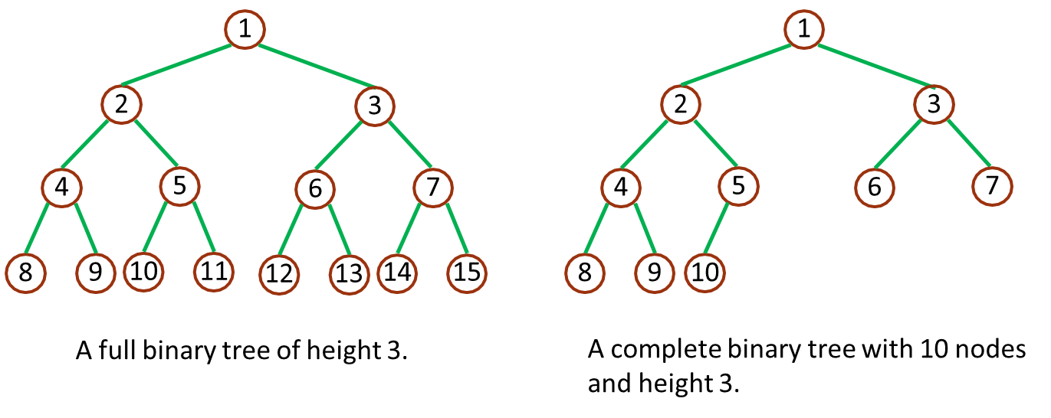
Binary tree representations

Slide 5
A heap (data structure) is a linear array that stores a nearly complete tree.
Only talking about binary heaps that store binary trees. nearly complete trees:
all levels except possibly the lowest one are filled
the bottom level is filled from left to right up to some point
Want to store trees like that to facilitate search in the tree.

Slide 6
Assignment of tree vertices to array elements
Very easy:
root is A[1]
given index i of some node, we have
Parent (i ) = [i/2]
Left(i ) = 2i
Right(i ) = 2i + 1
Implementation straightforward:
i → 2i
left-shift by one of bit string representing i
i → 2i + 1
left-shift by one plus adding a 1 to the last bit
i → [i/2]
right-shift by one

Slide 7
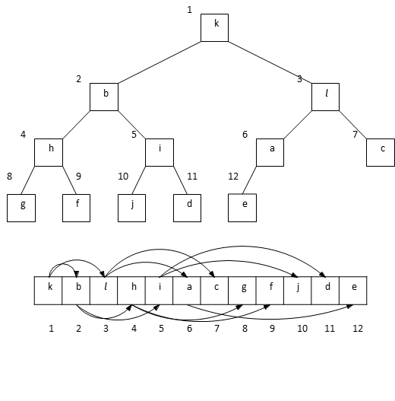
EX: Assignment of tree vertices to array elements

Slide 8
This particular vertex numbering isn’t the only requirement for the thing to be a proper heap
Two kinds: min-heaps and max-heaps
Both cases, values in nodes satisfy heap property
max-heap with max-heap property:
for every node i (other than root)
A[Parent(i )] ≥ A[i ]
meaning: value of node is at most value of parent, largest value is stored at root
min-heap with min-heap property:
for every node i (other than root)
A[Parent(i )] ≤ A[i ]
meaning: value of node is at least value of parent, smallest value is stored at root

Slide 9
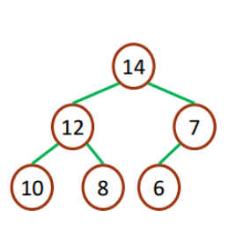
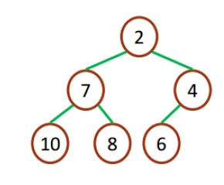
Max & Min Heaps Example
Max Heaps
Min Heaps

Slide 10
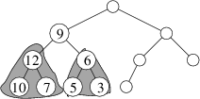
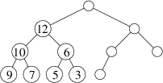
Maintains the max-heap property
Inputs are an array A and an index i
Assumption: sub-trees rooted in Left(i ) and Right(i ) are proper max-heaps, but A[i ] may be smaller than its children
Task of Max-Heapify is to let A[i ] float down in the max-heap below it so that heap rooted in i becomes proper max-heap

Slide 11
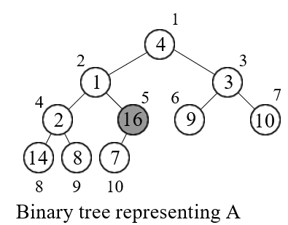
Example MAX-Heap
10\2=5 start from node 5
i=5

Slide 12
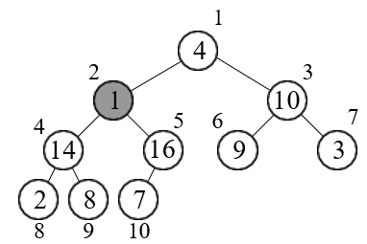
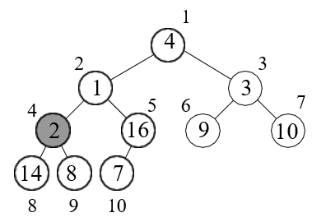
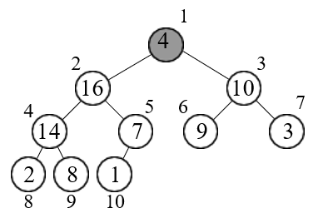
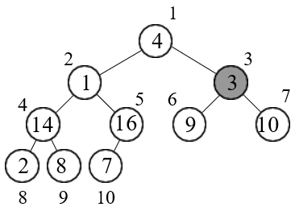
Example MAX-Heap Cont.
1
4
3
i=
2

Slide 13
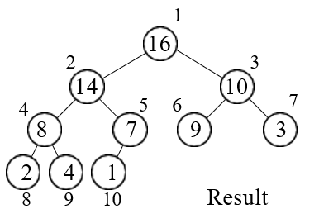
Example MAX-Heap Cont.
i=1

Slide 14
Priority queues
They are different: there’s no “real” FIFO rule anymore.
A priority queue maintains set S of elements, each with a key
(priority).
Two kinds: max-priority queues and min-priority queues, usually implemented by max-heaps and min-heaps.
Max-priority queue
Operations:
Insert(S, x ) inserts element x into set S
Maximum(S ) returns element of S with largest key Extract-Max(S ) removes and returns element of S with largest key
Increase-Key(S, x, k) increases x ’s key to new value k, assuming k is at least as large as x ’s old key
Min-priority queue is used via operations: Insert, Minimum, Extract-Min, and Decrease-Key

Slide 15
The Heapsort algorithm
Heapsort(A)
1 Build-Max-Heap(A)
2 for i ← length[A] down to 2
3 do exchange A[1]↔A[i]
4 heap-size[A] ← heap-size[A] -1
5 Max-Heapify(A,1)
Running time: O(n log n) (Build-Max takes O(n), and then O(n) rounds with O(log n) each).

Slide 16
Heap Sort
The heapsort algorithm consists of two phases: - build a heap from an arbitrary array - use the heap to sort the data
To sort the elements in the decreasing order, use a min heap
To sort the elements in the increasing order, use a max heap
19
12
16
1
4
7
19
12
16
1
4
7

Slide 17
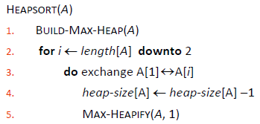
Heap Sort Cont.
Take out biggest
19
12
16
Move the last element
to the root
1
4
7
Sorted:
Array A
12
16
1
4
7
19

Slide 18
Heap Sort Cont.
7
swap
HEAPIFY()
12
16
1
4
Sorted:
Array A
7
12
16
1
4
19

Slide 19
Heap Sort Cont.
16
12
7
1
4
Sorted:
Array A
16
12
7
1
4
19

Slide 20
Heap Sort Cont.
Take out biggest
16
Move the last element
to the root
12
7
1
4
Sorted:
Array A
12
7
1
4
16
19

Slide 21
Heap Sort Cont.
4
12
7
1
Sorted:
Array A
4
12
7
1
16
19

Slide 22
Heap Sort Cont.
swap
4
HEAPIFY()
12
7
1
Sorted:
Array A
4
12
7
1
16
19

Slide 23
Heap Sort Cont.
12
4
7
1
Sorted:
Array A
12
4
7
1
16
19

Slide 24
Heap Sort Cont.
Take out biggest
12
Move the last
element to the
root
4
7
1
Sorted:
Array A
4
7
1
12
16
19

Slide 25
Heap Sort Cont.
1
swap
4
7
Sorted:
Array A
1
4
7
12
16
19

Slide 26
Heap Sort Cont.
7
4
1
Sorted:
Array A
7
4
1
12
16
19

Slide 27
Heap Sort Cont.
Take out biggest
7
Move the last
element to the
root
4
1
Sorted:
Array A
4
1
7
12
16
19

Slide 28
Heap Sort Cont.
1
4
Sorted:
Array A
1
4
7
12
16
19

Slide 29
Heap Sort Cont.
swap
1
HEAPIFY()
4
Sorted:
Array A
4
1
7
12
16
19

Slide 30
Heap Sort Cont.
Take out biggest
Move the last
element to the
root
4
1
Sorted:
Array A
1
4
7
12
16
19

Slide 31
Heap Sort Cont.
Take out biggest
1
Sorted:
Array A
1
4
7
12
16
19

Slide 32
Heap Sort Cont.
Sorted:
1
4
7
12
16
19

Slide 33
Thank You

